Slide 1
Management Development
What is management development and why should you do it?

Slide 2
Management Development
Most popular methods:
Managerial On-the-Job Training
The Case Study Method
Management Games
Outside Programs and Seminars
University-Related Programs
In-House Development Centers
Differential Development Assignments for Mission-Critical Employees

Slide 3
Managerial On-the-Job Training
Job Rotation
The Coaching or Understudy method
Action Learning

Slide 4
Job Rotation
Normally for general workers
Allows managers to learn about different departments quickly
Marriott found it to reduce turnover

Slide 5
The Coaching or Understudy Method
Six step method:
Establishing a relationship of trust between the coach and the coachee
Evaluating the coachee and the professional setting in which he or she works;
Providing feedback on this evaluation to the coachee;
Establishing a development plan and setting goals;
Implementing the behaviors to be developed or improved; and
Evaluating the progress achieved.

Slide 6
Action Learning
O’Neil and Marsick published in Advances in Developing Human Resources:
“An approach to working with and developing people that uses work on an actual project or problem as the way to learn. Participants work in small groups to take action to solve their problem and learn how to learn from that action. Often a learning coach works with the group in order to help the members learn how to balance their work with the learning from that work.”

Slide 7
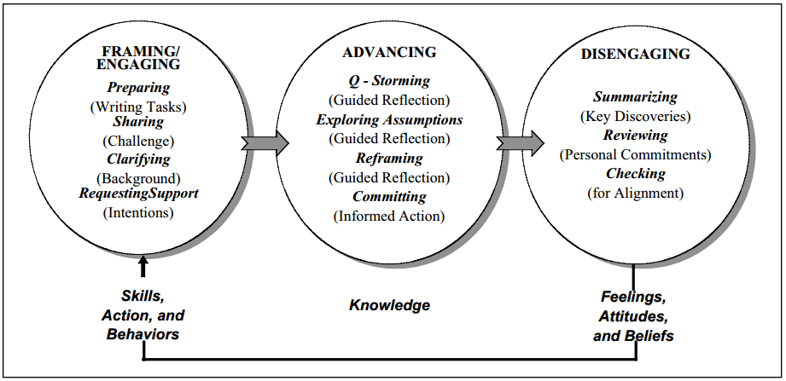
Action Learning

Slide 8
Action Learning
Key Benefits:
Sharing of Tacit knowledge and experiences
Converting tacit experiences into explicit knowledge
The team combines the knowledge that is shared by individuals
Sharing of problems and lessons learned
Reflection on experience of taking action
Addressing the intractable problems of the organization
Questioning insight and assumptions
Transforming organizational culture
Increasing self-awareness and building trust
Enabling action taking
Resolving real business problems
Improving social processes
And Empowering people

Slide 9

The Case Study Method

Slide 10
Management Games
Key Characteristics:
Physically or Computerized
Helps develop soft skills
Some of these games can be found at: http://mentoric.com

Slide 11
Management Games
Key Characteristics:
Physically or Computerized
Helps develop soft skills
Some of these games can be found at: http://mentoric.com

Slide 12

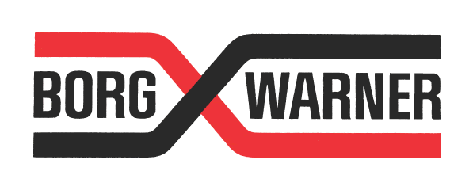
University-Related Programs

Slide 13
University-Related Programs
Programs at Western Carolina University
Accounting, Finance, Information Systems, and Economics
Business Administration and Law and Sport Management
Entrepreneurship, Sales and Marketing, and Hospitality and Tourism
And Global Management and Strategy

Slide 14
Joint programs with universities
Types of Joint programs
Financing additional education for employees
University seminars or lectures
Can help organizations develop specific development programs

Slide 15
Joint programs with universities
The Hasbro Example with Dartmouth
360-degree performance assessment at arrival
Individual coaching from executive coaches
MBA-like coursework guided by the executive’s needs
Utilized Action Learning teams with Hasbro’s coaches

Slide 16
In-House Development Centers
Types of Programs:
Classroom Learning
Assessment Centers
Online Learning

Slide 17

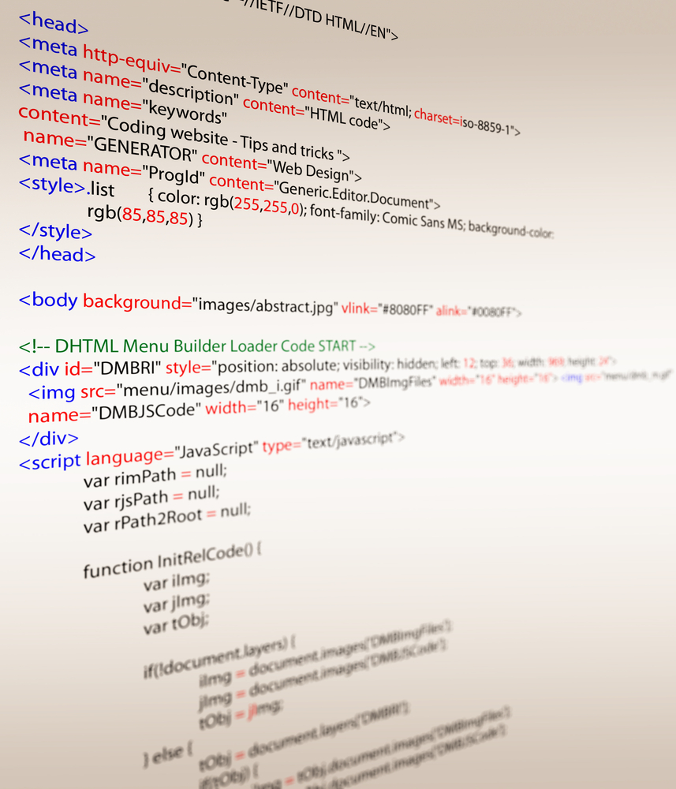
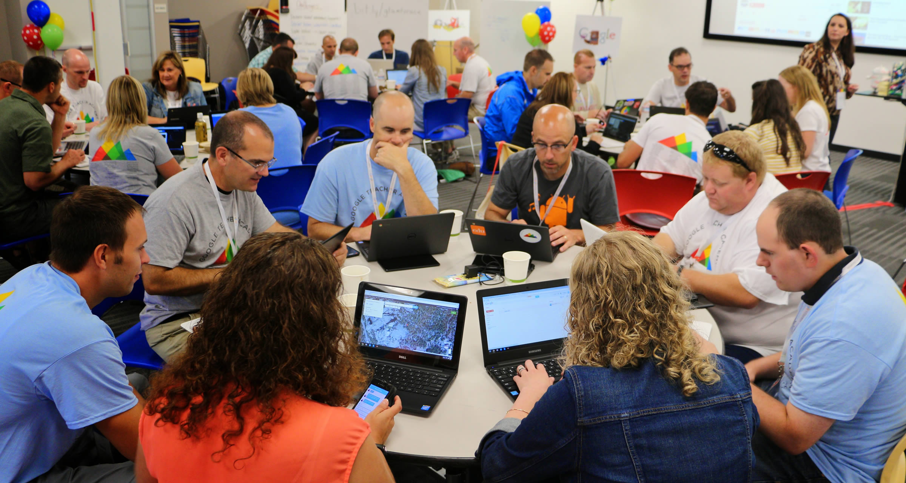
GoogleEDU

Slide 18
In-House Development Centers
Learning Portals:
Dynamic knowledge
Moderated content
Codified content

Slide 19
Differential Development Assignments for Mission-Critical Employees
Segmenting high performing employees through:
Business impant
High performers
High potentials
Critical skills

Slide 20
Five points about Management Development
Segmenting high performing employees through:
Management development is any attempt to improve managerial performance.
Management development’s ultimate goal is to enhance the organization’s performance.
Management development has to be relevant to the organization’s needs.
There are many methods of effective Management Development that have been proven effective.
The most popular methods for Management development are classroom-based learning, executive coaching, action learning, 360-degree feedback, experiential learning, off-site retreats, mentoring, and job rotation.

Slide 21
Q&A
Sources:
Ahmed, Ghosia, Gillian Ragsdell, and Wendy Olphert. "Knowledge Sharing In Project Teams: A Research Model Underpinned By Action Learning." Proceedings Of The International Conference On Intellectual Capital, Knowledge Management & Organizational Learning(2014): 455-464. Business Source Complete. Web. 14 Feb. 2015.
Dessler, Gary. A Framework for Human Resource Management. 7th ed. Upper Saddle River, NJ: Pearson Prentice Hall, 2013. Print.
Leemkuil, Heny and Ton De Jong, “Adaptive Advice in Learning With a Computer-Based Knowledge Management Simulation Game.” Academy of Management Learning & Education 11.4 (2012):653-665. Business Source Complete. Web. 14 Feb. 2015.
Nalbantian, Haig R., and Richard A. Guzzo. "Making Mobility Matter." Harvard Business Review 87.3 (2009): 76-84. Business Source Complete. Web. 14 Feb. 2015.
O’Neil, Judy and Victoria J. Marsick. “Action Learning Coaching.” Advances in Developing Human Resources 16.2 (2014): 202-221. Sage Publications. Web 14 Feb 2015.
Walker, Joseph. "School's in Session at Google." The Wall Street Journal. 5 July 2012. Web. 16 Feb. 2015.<http://www.wsj.com/articles/SB10001424052702303410404577466852658514144>.

